Slide 1



01/11
16/03/2026
WATER STRESS IN LAVANDER
PRESENTED BY:
Aly Abdelmotaleb - Ahmed Ali - Osama Mohamed

Slide 2


02/11
Agenda
01 | Overview
02 | Dataset Segmentation
03 | approaches for this problem
04 | Upcomming work
05 | Summary

Slide 3


03/11
Overview
Detecting water stress in lavender plants traditionally relies on chemical analysis. To provide a faster alternative, our project uses deep learning and image classification to observe early morphological changes in the plants. We aim to develop a reliable model that can detect these early visual markers of stress directly from images, completely bypassing the need for chemical testing.
Goal 1: Classify Stress vs. No Stress
Goal 2: Extract Visual Features
Goal 3: Enable Early Detection
Develop a reliable image classification model to determine whether a plant has undergone water stress or not.
Identify the specific visual elements in the plant images that indicate water stress using activation maps
Extract key early markers that could allow a real observer to quickly identify water stress

Slide 4
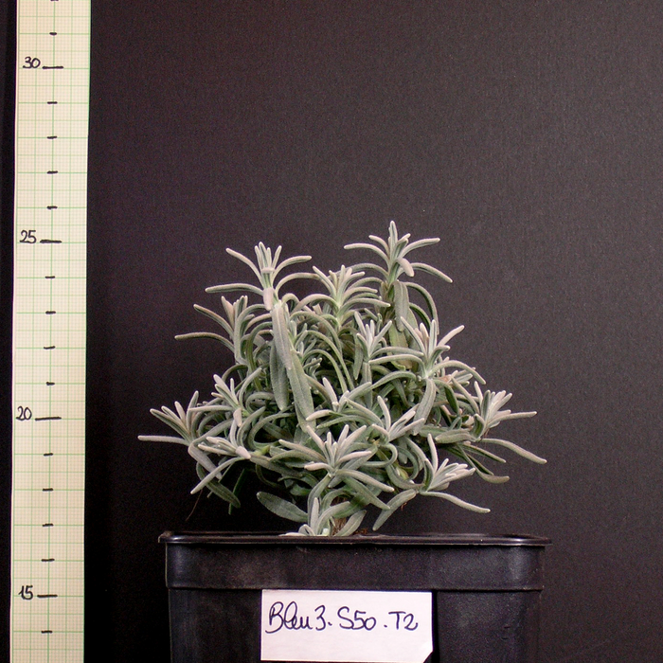
04/11
Data Set Overview
Goal: Detect water stress in lavender plants from images by identifying early visual changes.
60 lavender plants (different varieties)
• 3 water stress levels: S50, S25, S10
• Images captured at: T0, T2, T4
• Dataset size decreases over time (60 → 52 → 32) due to sampling for analysis

Slide 5
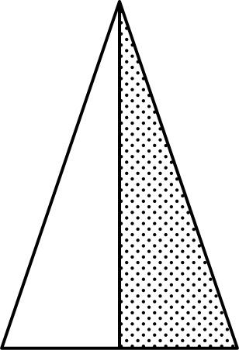
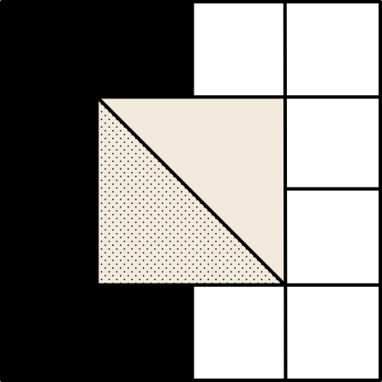
Preprocessing
05/11
First Step
Second Step
Third Step
Fourth Step
Analyze the dataset
Standardize the Images
Unify the image sizes 1024
Split the Dataset

Slide 6
Preprocessing
06/11
Splitting the Data Set
Time / Stress level | S50 | S25 | S10
T0 | --- | Not Stressed | Not stressed
T2 | Not Stressed | Stressed | Stressed
T4 | Not Stressed | Stressed | Stressed

Slide 7
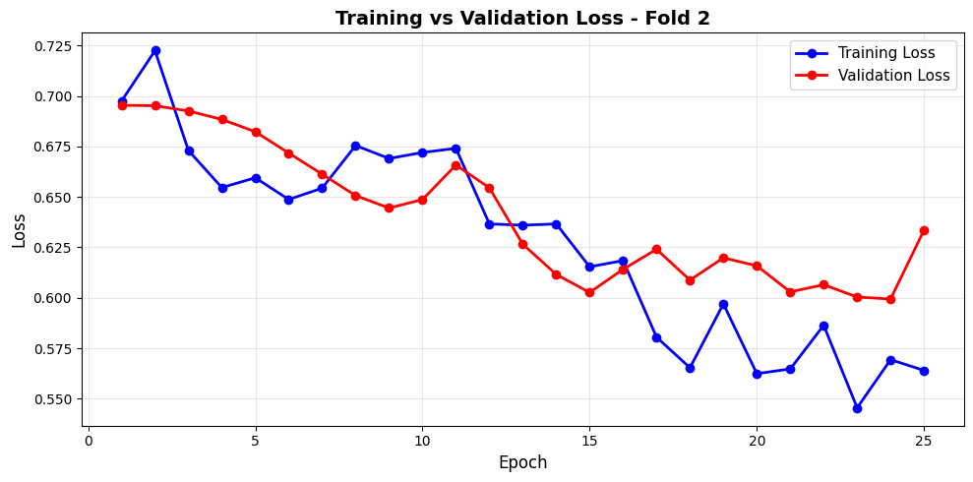
07/11
Approaches for the classification
1- Simple Approach
Architecture: Custom 4-block CNN (Conv → BatchNorm → ReLU → MaxPool) with a 512-unit fully connected classifier and 50% dropout.
Validation: 5-Fold Stratified Cross-Validation to maintain class balance.
The Results: Mean accuracy of 62.57% with a standard deviation of ~7%. Performance swings significantly across splits, from 52.1% (Fold 5) to 70.8% (Fold 3).
which implies a little bit of overfitting in that case

Slide 8
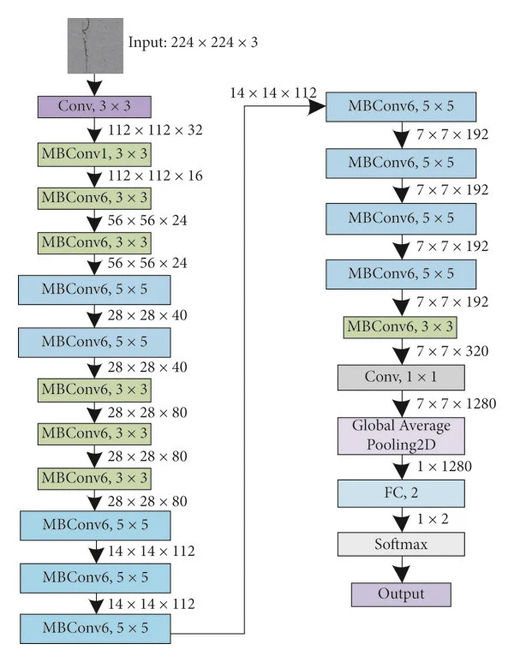
08/11
Approaches for the classification
2- Transfer Learning
Architecture: EfficientNet-B0 pretrained on ImageNet, fine-tuned with a two-stage strategy. The backbone is first frozen while only the custom head (Linear 1280 → 2) is trained, then the last convolutional block is progressively unfrozen for domain adaptation with differential learning rates (backbone: 1e-4, head: 1e-3).
Validation & Training Setup: 5-fold stratified cross-validation was used to preserve class balance, with heavy augmentation (flips, rotation, color jitter, blur, random erasing) to combat overfitting on the small 118-image dataset.

Slide 9
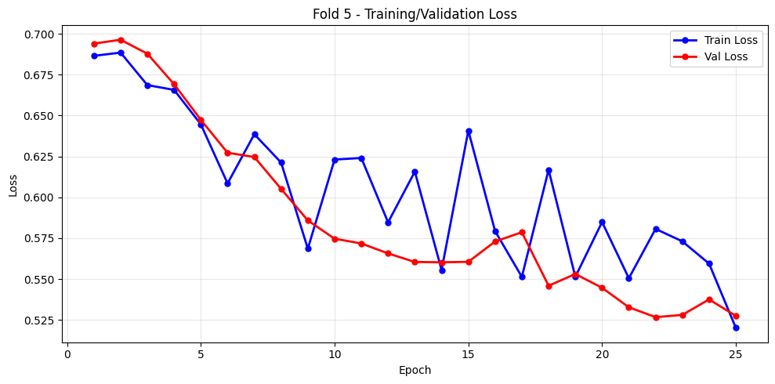
09/11
Approaches for the classification
2- Transfer Learning
Results: The model achieved a mean accuracy of 67.83% (±6.1%). Performance was inconsistent across folds, ranging from 58.3% to 75.0%, with the stressed class being the hardest to detect likely due to class imbalance and the very limited ~94 training images per fold. These results are consistent with those observed in the simpler baseline approach, yielding similar accuracies and class-level trends.

Slide 10
10/11
Upcomming work
Optimize Transfer Learning: Experiment with different pre-trained architectures and fine-tuning strategies to stabilize the model and maximize validation performance.
Refine the Custom Baseline: Fine-tune the initial simple CNN architecture to maximize its performance potential and establish a strong benchmark.
Extract Visual Markers: Analyze activation maps to isolate the specific morphological features the model relies on to detect water stress.
Ground-Truth Validation: Cross-reference the model's highlighted features with real-world botanical observations to confirm they are accurate, early indicators of stress.

Slide 11
11/11
Thank you

